Slide 1
. PSCS-65 : AI-based tool forpreliminary diagnosis of Dermatologicalmanifestations
STUDENT NAME | ROLL NUMBER
20211CSE0640 | ANUSHA MALIPATIL
20211CSE0646 | SNEHA S BALLARI
20211CSE0675 | THAKSHA PRABHAKAR
20211CSE0676 | SNEHA A
Under the Supervision of,
Mr.Ramesh T
Assistant Professor
School of Computer Science and Engineering
Presidency University
.
Name of the Program: CSE
Name of the HoD: Dr.Asif Mohammed H.B
Name of the Program Project Coordinator: Mr. Amarnath J.L & Dr. Jayanthi. K.
Name of the School Project Coordinators: Dr. Sampath A K / Mr. Md Ziaur Rahman

Slide 2
Introduction
Overview of AI-based Tool for Preliminary Diagnosis of Dermatological Manifestations
Objective: Early detection of common skin conditions using image analysis and machine learning algorithms
Enhances accessibility to dermatological care, especially in underserved or remote areas
Model Used: Fine-tuned MobileNetV2 model integrated with Gradio for real-time, user-friendly predictions (achieved 91.2% accuracy).

Slide 3
Significance of the Project
Bridges the healthcare gap by offering accessible skin disease diagnostics in underserved and rural regions where dermatologists may be scarce.
Enables early detection of skin conditions, helping to reduce complications and improve treatment outcomes through timely intervention.
Empowers non-specialists (e.g., frontline health workers, caregivers) to screen and assess common skin diseases using just a smartphone or web-enabled device.
Supports telemedicine by acting as a preliminary diagnostic tool, reducing patient load on clinics and streamlining remote consultations.

Slide 4
Challenges Faced
Limited annotated datasets
High inter-class similarity
Deployment complexity
Data imbalance
Ensuring generalizability

Slide 5
Proposed Solution
Utilized transfer learning with MobileNetV2.
Data augmentation techniques
Class balancing strategies.
Optimized Gradio interface
Model validation and fine-tuning.

Slide 6
Methodology
Data Collection & Preprocessing: Gathered and preprocessed dermatological images.
Model Selection & Transfer Learning: Used and fine-tuned MobileNetV2.
Data Augmentation: Applied rotation and flipping to prevent overfitting.
Model Training: Split data and trained while monitoring performance.
Interface Integration: Built a Gradio interface for real-time predictions.
Evaluation & Deployment: Achieved 91.2% accuracy and deployed online.

Slide 7
System Workflow
Image Input: User uploads or captures an image of the affected skin region via the Gradio web interface.
Preprocessing: The system resizes, normalizes, and processes the input image to match the input requirements of the model.
Model Prediction: The preprocessed image is passed to the fine-tuned MobileNetV2 model.The model analyzes the image and predicts the most likely skin disease from five predefined categories.
Output Generation: The system displays the predicted disease along with a confidence score.
User InteractionUsers can submit multiple images for analysis and receive real-time predictions.Designed to be lightweight and fast to ensure accessibility even in low-resource environments.

Slide 8
Tools and Technologies
TensorFlow
MobileNetV2
Gradio
Python
NumPy
OpenCV
Google Colab
GitHub

Slide 9
Outcomes
High Accuracy: Achieved 91.2% accuracy in classifying five skin diseases using a fine-tuned MobileNetV2 model.
Real-Time Predictions: Provided instant, reliable results through a user-friendly Gradio interface.
Accessible in Resource-Constrained Areas: Designed to support early dermatological diagnosis in underserved regions.
User Feedback: Received positive responses for usability and responsiveness, indicating effectiveness in real-world scenarios.

Slide 10
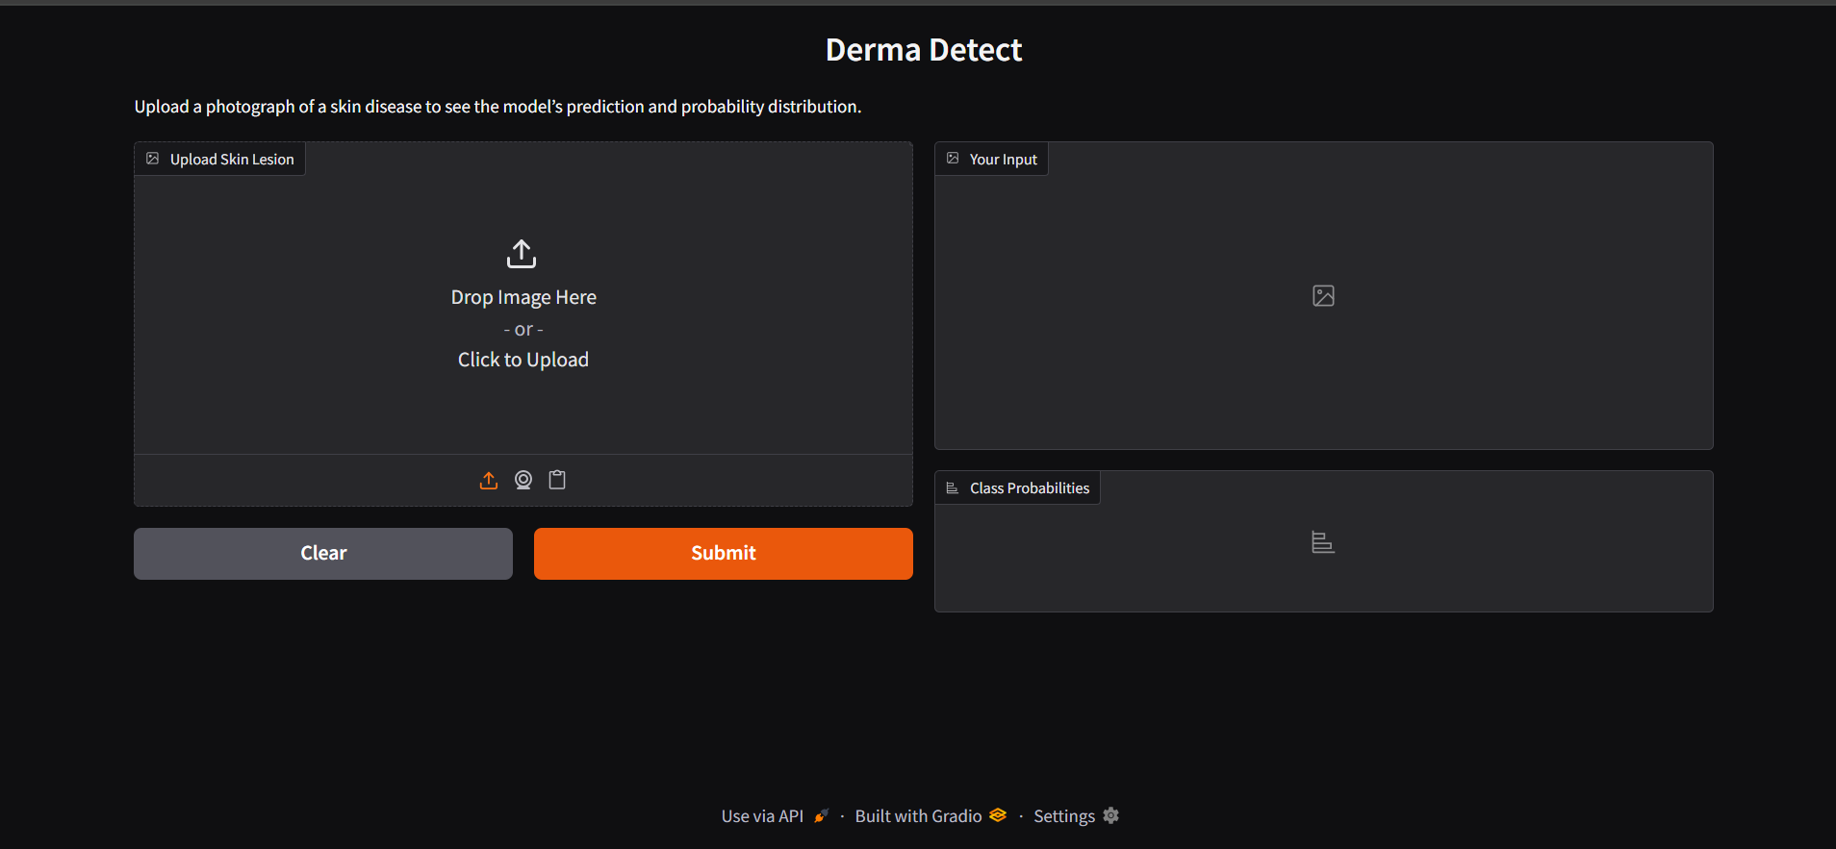
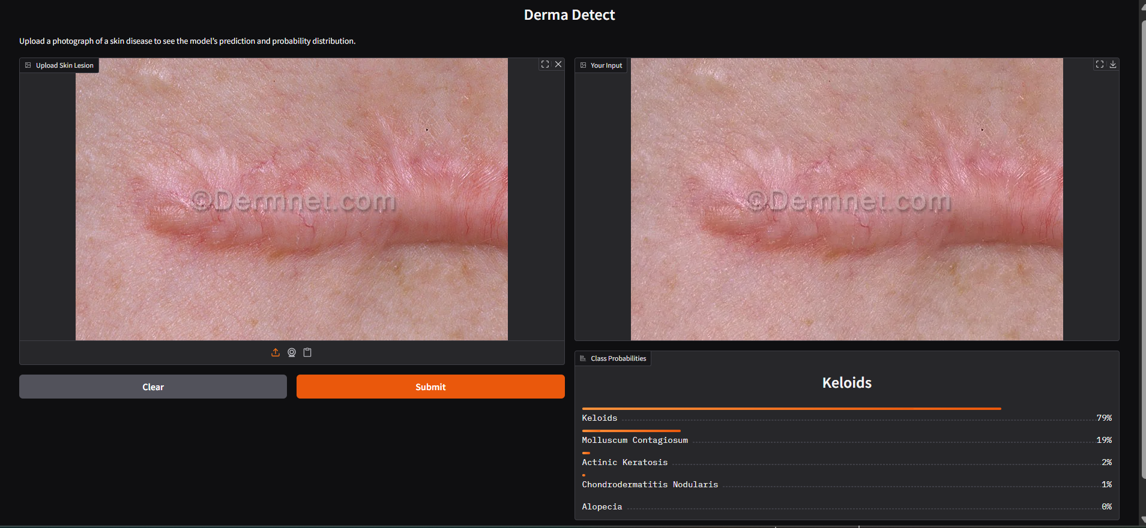
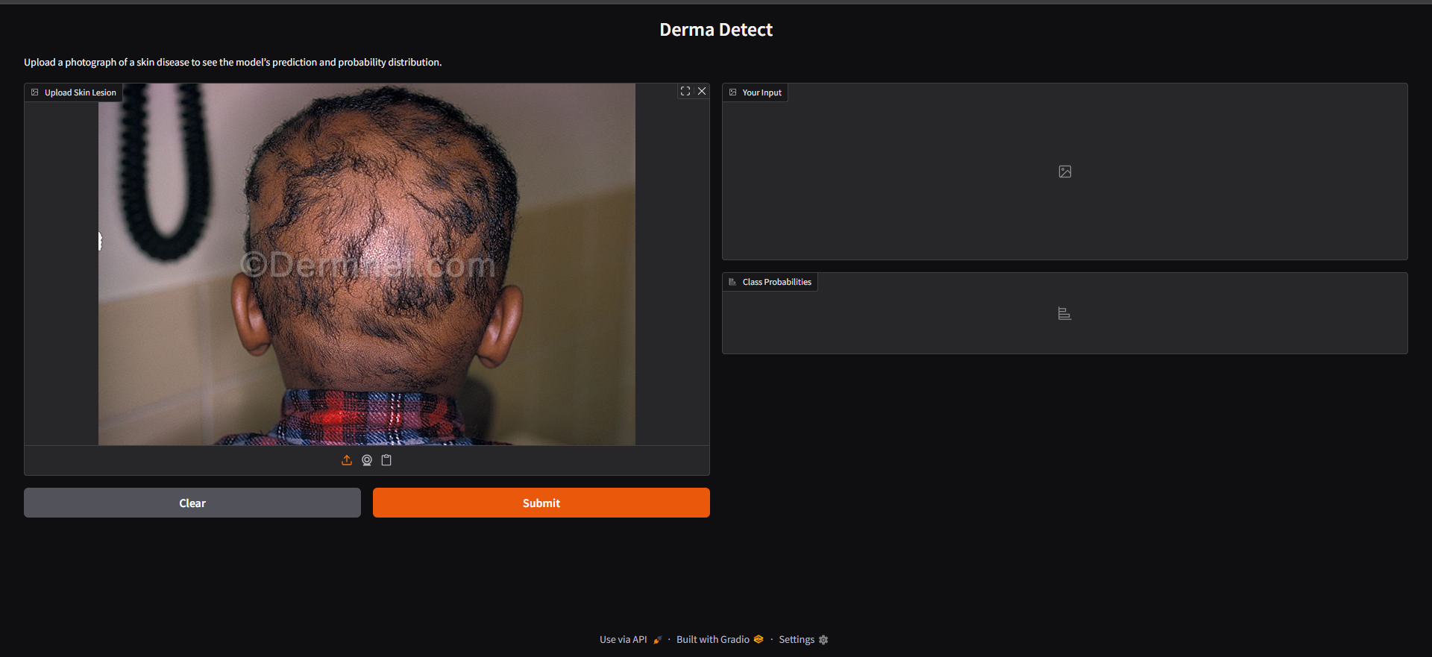
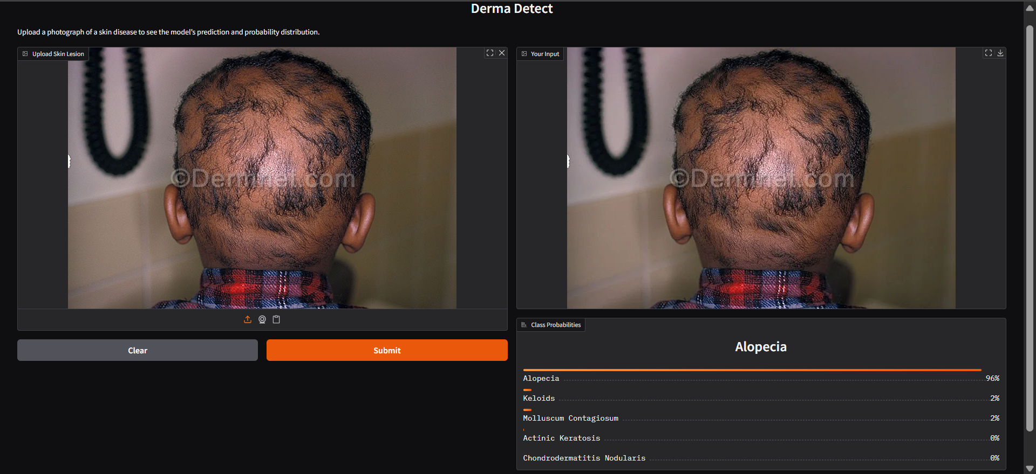
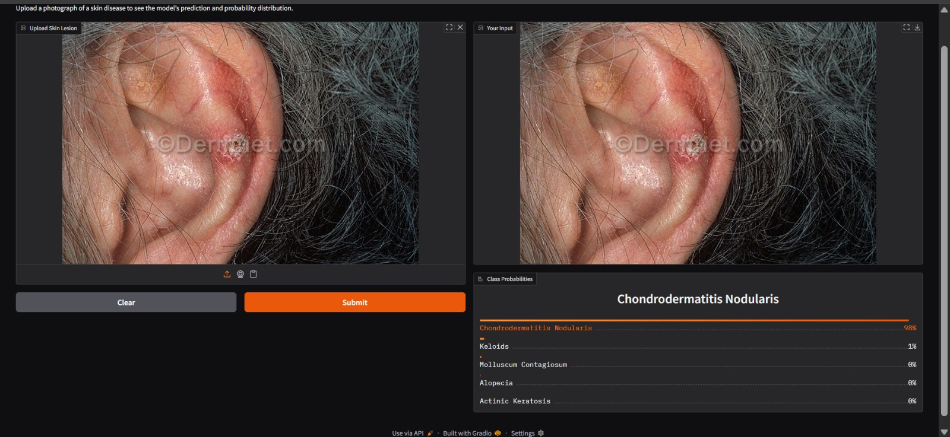
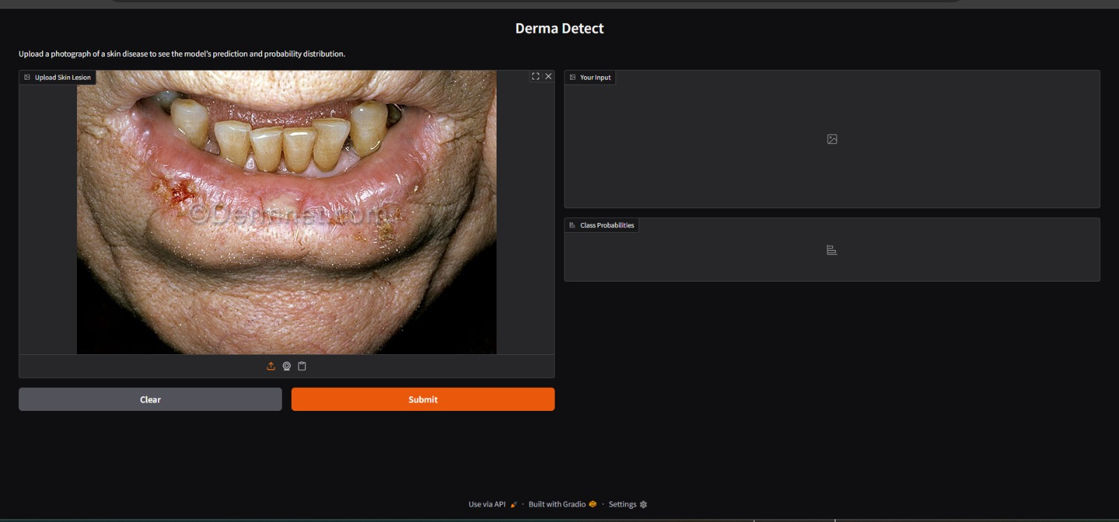
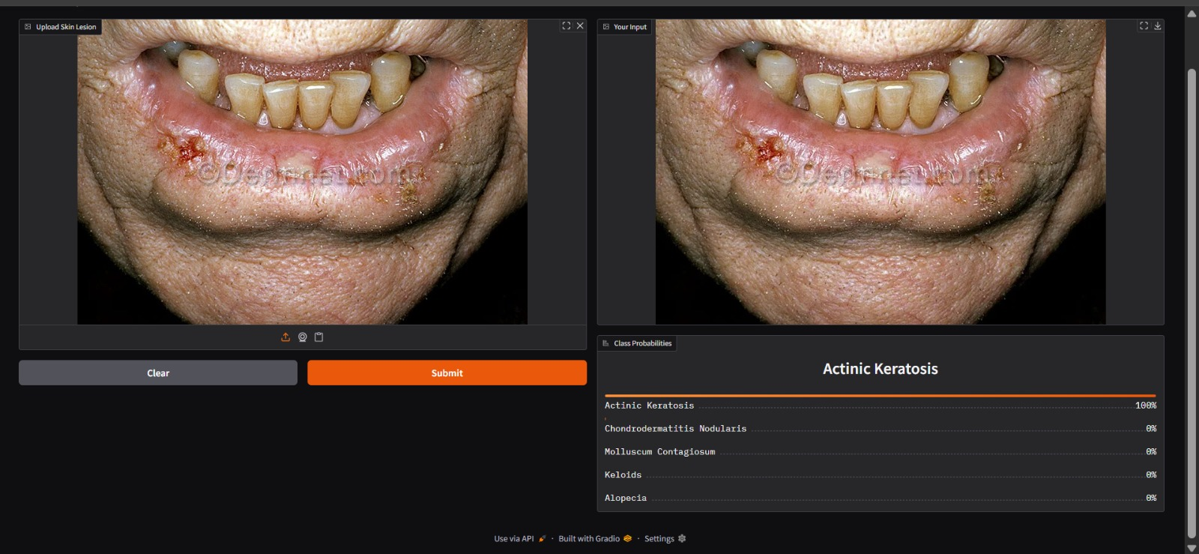
SCREENSHOTS

Slide 11
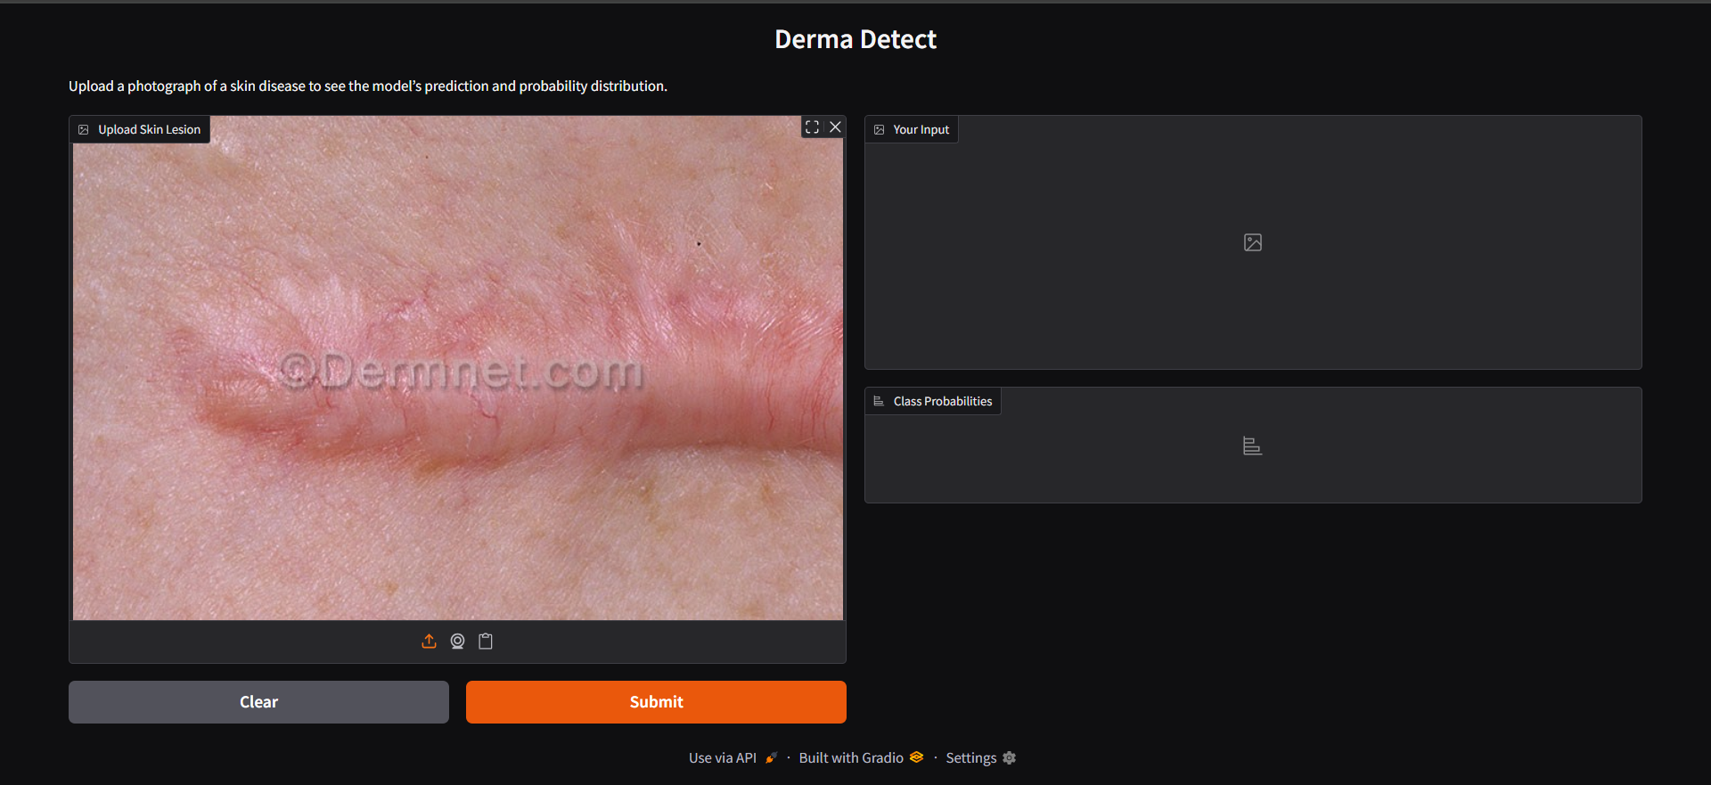

Slide 13
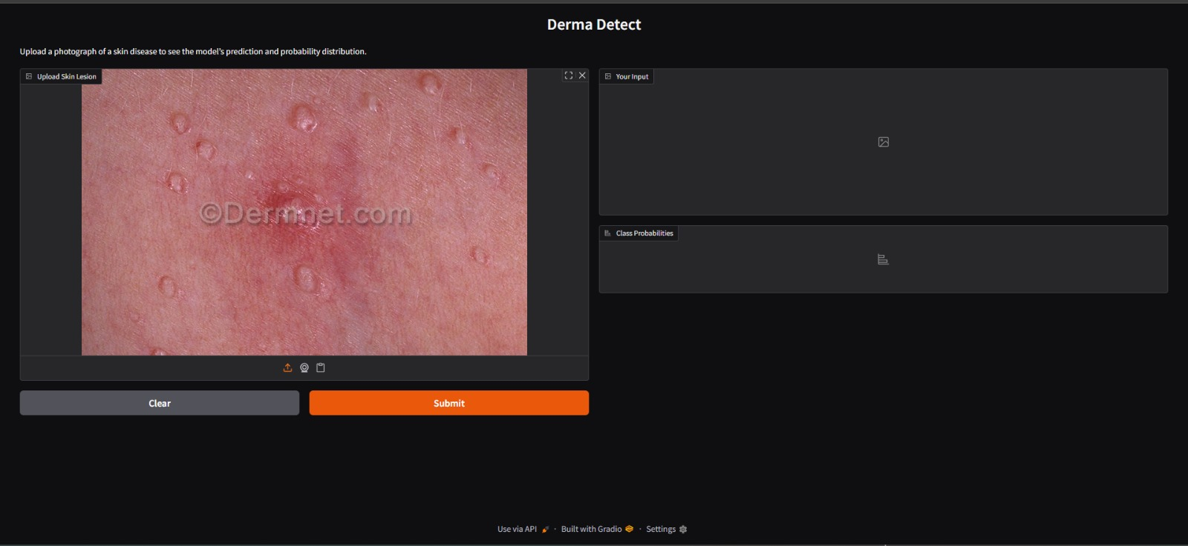
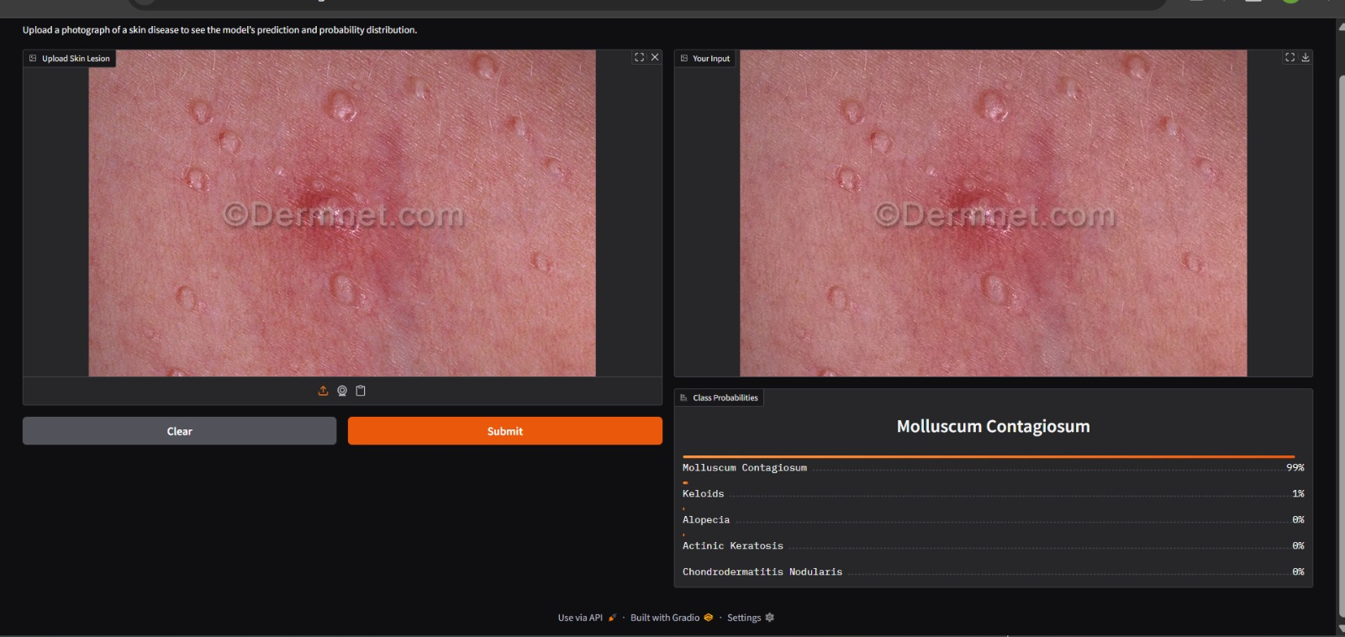

Slide 14
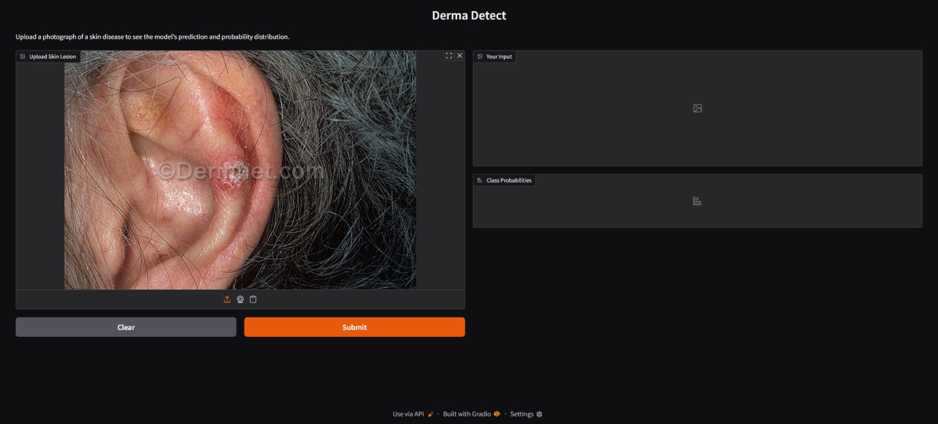

Slide 16
Github Link
https://github.com/snehaballari/DermaDetect.git

Slide 17
Conclusion
DermaDetect utilizes deep learning for real-time skin disease classification.
Achieved 91.2% accuracy in classifying five skin diseases.
Aims to enhance early diagnosis and improve healthcare accessibility.
Designed to be particularly useful in resource-constrained settings.
Provides a valuable tool for dermatological care in underserved areas.

Slide 18


